Slide 1
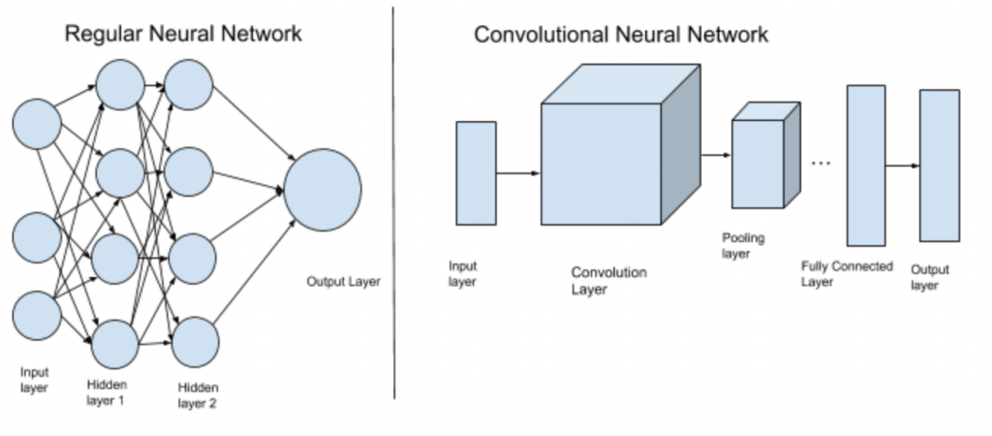
CNN INTRO

Slide 2
CONVOLUTION NEURAL NETWORK
Type of Deep Neural Network
Analyzing visual imagery (Detect cat, faces or objects)
Used in image & video recognition, natural language processing, recommender system, medical analysis
Currently used in self driving cars and robots
Future possibility: self-diagnoses of medical problems

Slide 3
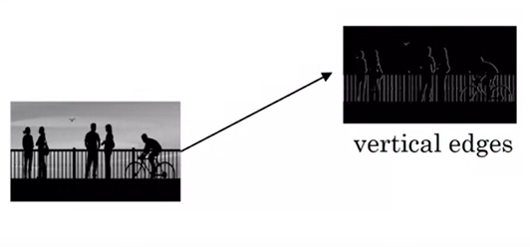
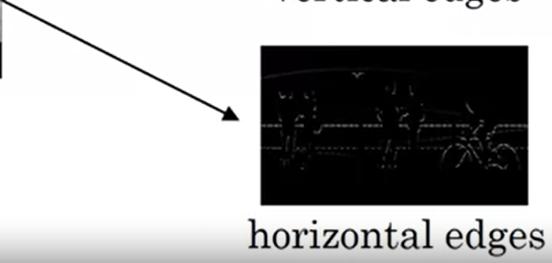
EDGE Detection

Slide 4
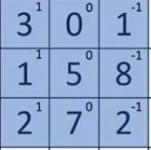
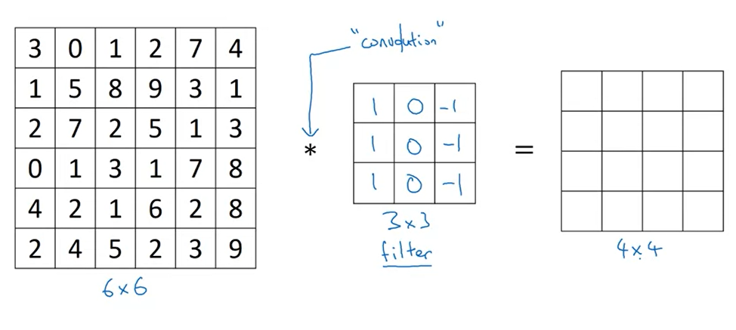
VERTICAL EDGE Detection
3x1 + 1x1 + 2x1 + 0x0 + 5x0 + 7x0 + 1x-1 + 8x-1 + 2x-1 = -5

Slide 5
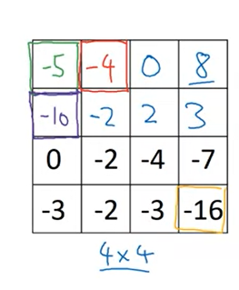
VERTICAL EDGE Detection
(n-f+1 x n-f+1)
Python: conv-forward
Tensorflow: tf.nn.conv2d
Keras: conv2d

Slide 6
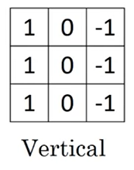
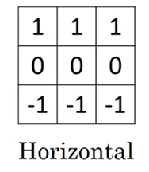
EDGE Detection Example
Vertical Edge
Horizontal Edge

Slide 7
PADDING
To overcome the convolution effects
Shrinking output
Throwing information on edges
Preserve the original input
Types: Valid & Same convolution
Valid has no padding
Same Convolution to keep the output size same as input

Slide 8
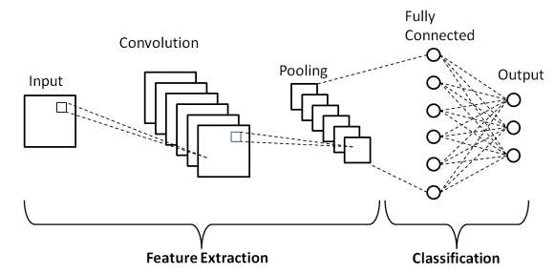
TYPE OF LAYERS IN CNN
Convolution
Pooling
Fully Connected layers

Slide 9
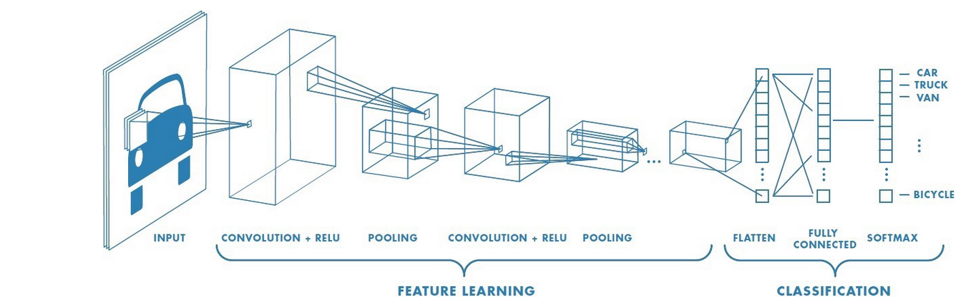
Convolution
Building block used in CNN
Handle big input images
Prevent neural network from overfitting
Application of a filter to an input that results in an activation

Slide 10
POLLING LAYERS
Downsampling operation
Reduce the size of the representation
To speed the computation
Applied after convolution layer

Slide 11
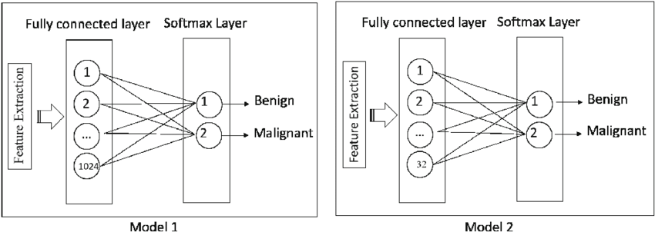
FULLY CONNECTED NEURAL NETWORK
Found towards the end of CNN architectures
To optimize the final result
Softmax gives the probability distribution of the label

Slide 12
THE END

